Slide 1
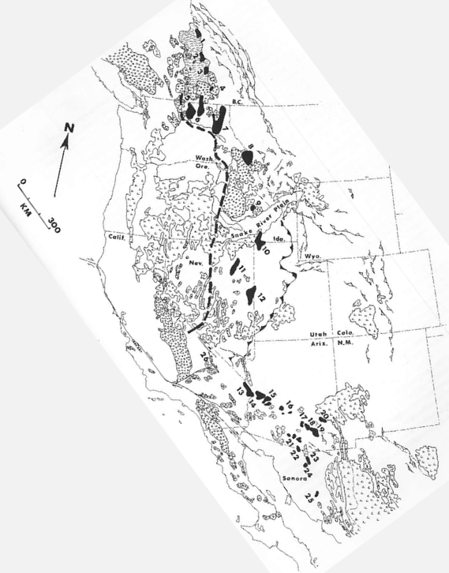
Cordilleran metamorphic core complexes: an overview
Coney 1980
Cordilleran metamorphic core complexes: Cenozoic extensional relics of Mesozoic compression
Coney 1984
Geol 730 Presentation By: Neal Mankins
(Coney, 1980)

Slide 2
Purpose
Questions
To examine the tectonic significance of this metamorphic core complexes in the evolution of mountain systems (Coney, 1980)
To establish the relationship and timing of metamorphic core complexes within the cordilleran (Coney, 1984)
What defines a metamorphic core complex?
When were cordilleran metamorphic core complexes formed?
What tectonic processes cause them to form?
Method
Literature Review (Coney, 1980)
Restoring extension values and crustal attenuation on restored base maps “paleocrustal isopach maps” (Coney, 1984)

Slide 3
Background
Characteristics
“Heterogeneous metamorphic-pluton basement terrane overprinted by low-dipping lineated and foliated mylonitic and gneissic fabrics”
North American cordilleran has 25 distinct metamorphic terrannes
Complexes formed post Sevier & Laramide orogeny but pre-date basin & range extension
All 25 core complexes are inboard of the 0.706SR/SR contour line
Nestanet.org
(Coney, 1980)

Slide 4
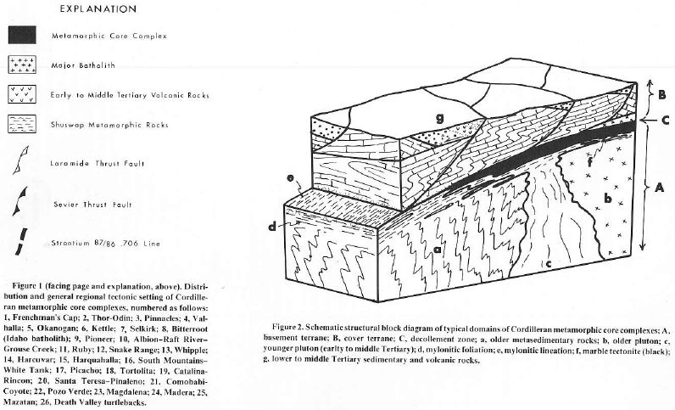
Cover Terrane
1. What defines a metamorphic core complex?)
Unmetamorphosed Cover Terrane
Unmetamorphosed rocks separated from basement by decollement
Cover is typically heavily eroded often leaving just patches known as “Klippen”
Faulting can be extensive here but never penetrates to the basement
Extension in this package can be dramatic (>2km in some terranes)
(Coney, 1980))

Slide 5
Basement Terrane
Basement Terrane
Low-dipping foliation (rarely >30°) in mylonitic gneiss that follows the strike of overall domal/archlike shape
Terranes have several protoliths
Mineral lineation in >15 complexes (400km in S Arizona & N Mexico) bear N60°E where complexes to the N are more variable but are ~W-NW lineated
At deep levels larger plutons are homogenous but closer to the decollement the more progressive the foliation and lineation becomes
(Coney, 1980))

Slide 6
Decollement
Decollement Zone
Typically occurs along the Precambrian-phanerozoic unconformity
Decollement is often highly polished, has slickenslides, and rock adjacent can have aspects of “fused plate” “tectonite”
Adjacent rock can show extensive alteration with retrograde chlorite and hematite stained groundmass within breccias
Usually subparallel or parallel to underlying mylonitic or gneissic fabric
Marks a discontinuity of extreme ductility contrast (brittle above, ductile below)
Plutons never cross the decollement
(Coney, 1980))

Slide 7
Tectonic Setting
Link between thrust belts & core complexes?
Western Belt
Typically occurs as a metamorphic sheath below/within Cordilleran batholiths
This belt extends from the Canadian coastal plutonic complex, through the Idaho batholith & Sierra Nevada southward into western Mexico
Eastern Belt
Typically occurs
Extends from the eastern cordilleran in Canada through British Columbia & NW Washington where it merges with the Western Belt in the Idaho batholith but separates again to eastern Nevada and SE Arizona int the Sonora
Northern Complexes (Nevada & North)
Typically occur in the “hinterland” behind the folds & thrusts of the foreland
Hinterland accompanied metamorphism during thrusting in the foreland
Generally older (Cretaceous)
Arizona & Sonora Complexes
Typically occur within the Laramide belt of deformation
Deformation here was deeper seated than the northern complexes (involving both cover & basement rock)
Generally younger (Tertiary)
(Coney, 1980))

Slide 8
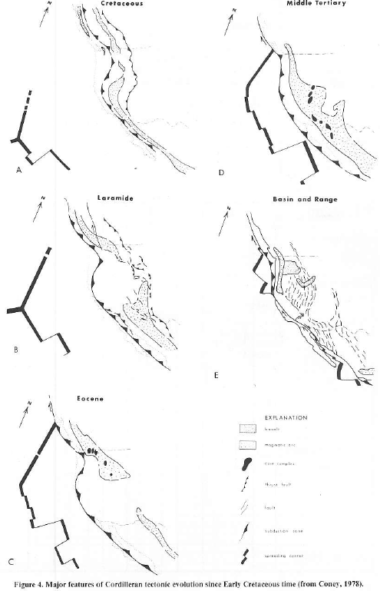
Interpretation
(Coney, 1980))
Mesozoic Aspect
Mesozoic uplift of hinderland produced from crustal thickening behind telescoping thrust belts to the east
Tertiary Aspect
Tertiary mylonitic fabrics overprint Mesozoic metamorphic & deformational features in many complexes
These events have reset K-AR dates as young as 18m.y.
Many complexes are characterized by Tertiary granitic plutons superimposed by late mylonitic fabrics

Slide 9
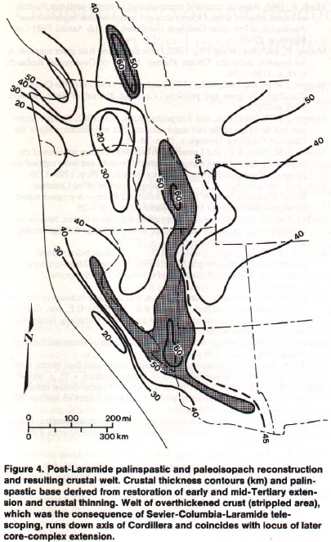
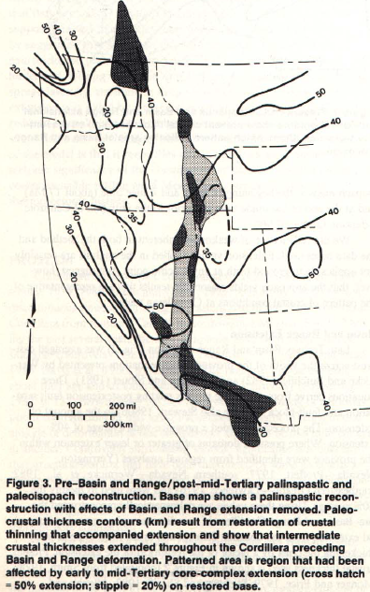
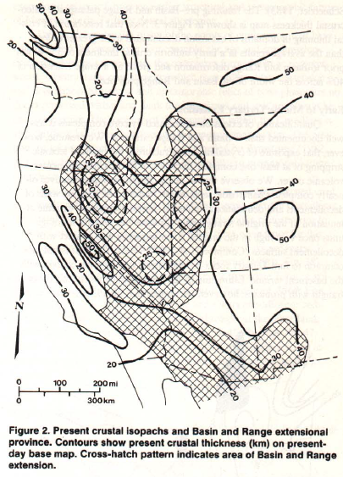
(Coney, 1984))
Post Laramide paleoisopachs)
Post-mid Tertiary paleoisopachs)
Present crustal isopachs)

Slide 10
Interpretation
(Coney, 1984))
Tectonic Implications
Overthickened crustal welt ~50-60km thick formed in the metamorphic hinterland, behind Mid Jurassic-Early Tertiary thrust faulting
Welt experienced deep-seated crustal extension in core complexes from Eocene-Miocene due to gravitational instability
Welt formed variably throughout space & time (not uniform)

Slide 11
Findings
2. When did they form?
55-15m.y. just prior to & during the ignimbrite flareup (post Laramide but pre-basin & range) (Coney, 1980)
~170-60m.y. crustal welt formation then crustal extension ~55-15m.y. (Coney, 1984)
3. Why did they form?
Process began during North America-Farallon plate convergence within a magmatic arc (because of flat slab subduction?) (Coney, 1980)
Mesozoic crustal telescoping resulting in an overthickened plateaulike crustal welt along the cordilleran hinterland that became gravitationally unstable in the Cenozoic and spread laterally resulting in extension (Coney, 1984)

